Slide 1
CHAPTER 1: Distributed System Models and Enabling Technologies
Technologies for Network-Based Systems
1.2.1 Multicore CPUs and Multithreading Technologies
1.2.2 GPU Computing to Exascale and Beyond
1.2.3 Memory, Storage, and Wide-Area Networking
1.2.4 Virtual Machines and Virtualization Middleware
1.2.5 Data Center Virtualization for Cloud Computing

Slide 2
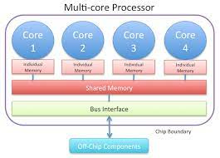
Technologies for Network-Based Systems
Multi-core CPUs and Multithreading Technologies
A multi-core processor is a computer processor integrated with 2 or more separate processing units, called cores.
Each of these cores reads and executes program instructions, as if the computer had several processors.

Slide 3
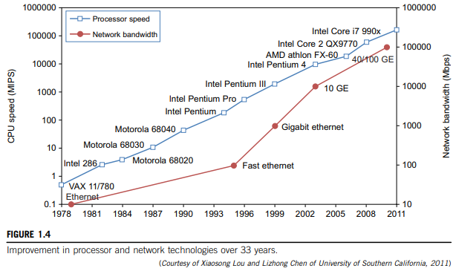
Figure 1.4 demonstrates the growth of processor and network technologies ( crucial for development of HPC & HTC Systems).
MIPS- millions of instructions per second
Mbps – megabits per second

Slide 4
Advances in CPU Processors
Present CPU’s - a multi-core architecture (dual, quad, six, or more processing cores).
Clock rate - increased from 10 MHz to 4 GHz (in 30 years).
However, the clock rate reached its limit on CMOS (complementary metal-oxide semiconductor) chips due to power limitations.
  Cannot increase - excessive heat generation & current leakage.
ILP is highly exploited in modern CPU processors.
DLP & TLP are highly exploited in graphical processing units (GPUs).
Both multi-core CPU & many-core GPU processors
- handle multiple instruction threads at different magnitudes today.

Slide 5
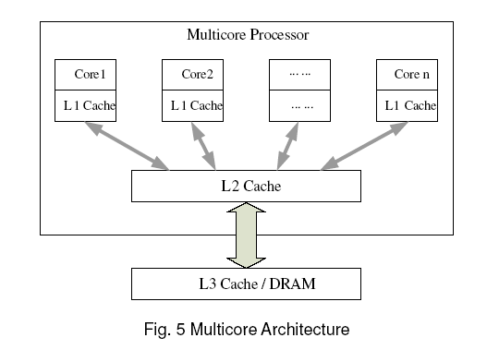
Architecture of a typical multi core processor:
LI cache is private to each core, L2 cache is shared and L3 cache or DRAM is
off the chip.
Ex of multi-core CPUs include Intel i7, Xeon, AMD Opteron.
Each core can also be multithreaded.
Ex: Niagara II has 8 cores - each core handling 8 threads (a total of 64 threads maximum).

Slide 6
Multicore CPU and Many-Core GPU Architectures
Multicore CPUs may increase - tens of cores to hundreds or more in the future.
But, CPU reached its limit in terms of DLP - due to the memory problem.
Triggered the development of many-core GPUs with hundreds or more thin cores.
IA-32 and IA-64 instruction set architectures are built into commercial CPUs.
x-86 processors - extended to serve HPC and HTC systems in some highend server processors.
Many RISC processors - replaced with multicore x-86 processors and many-core GPUs (in Top 500 systems).

Slide 7
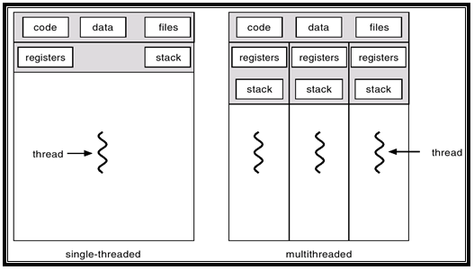
Multithreading Technology
Threads:
A basic unit of CPU utilization (a thread id, a program counter, a register set and a stack).
It shares its code, data section & other resources like memory with other threads belonging to same process.
If a process has multiple threads of control, it can perform more than one task simultaneously.

Slide 8
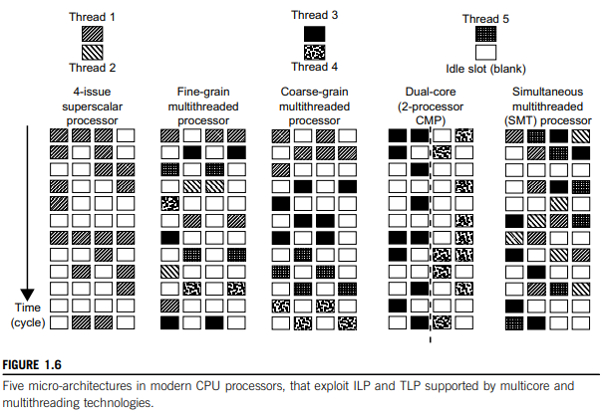
Below figure dispatches 5 independent threads of instructions to 4 pipelines paths (functional paths) in each of the following 5 processor categories:

Slide 9
Note: Instructions from different threads are distinguished by specific shading patterns for instructions from five independent threads.
Superscalar processor : single-threaded with 4 functional units . Only instructions from the same thread are executed in a superscalar processor.
Fine-grain multithreading: switches execution of instructions from different threads per cycle.
Course-grain multithreading: executes many instructions from the same thread for quite a few cycles before switching to another thread.
Multi core CMP (Cellular Multi-processing): executes instructions from different threads completely.
Simultaneous multithreaded (SMT): allows simultaneous scheduling of instructions from different threads in the same cycle.

Slide 10
GPU Computing to Exascale and Beyond
GPU: a graphics coprocessor or accelerator mounted on a computer’s graphics card or video card.
GPU offloads the CPU from tedious graphics tasks in video editing applications.
These GPU chips can process a minimum of 10 million polygons per second.
Used in nearly every computer on the market today.
Some GPU features - integrated into certain CPUs.
Traditional CPUs - structured with only a few cores.
A modern GPU chip - can be built with hundreds of processing cores.

Slide 11
How GPUs Work
Early GPUs functioned as coprocessors attached to the CPU.
Today, NVIDIA GPU - upgraded to 128 cores on a single chip.
Further, each core on a GPU - can handle eight threads of instructions.
Thus, up to 1024 threads can be executed concurrently on a single GPU.
A true massive parallelism, compared to few threads (handled by CPU).
Modern GPUs are not restricted to accelerated graphics or video coding.
Used in HPC systems to power supercomputers.

Slide 12
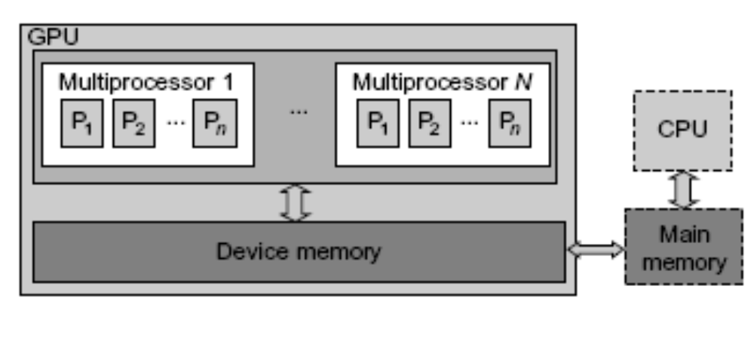
GPU Programming Model
The CPU instructs the GPU to perform massive data processing.
Bandwidth must be matched between on-board main memory & on-chip GPU memory.
This process is carried out in NVIDIA’s CUDA programming using the GeForce 8800 or Tesla and Fermi GPUs.
Architecture of A Many-Core Multiprocessor GPU interacting
with a CPU Processor

Slide 13
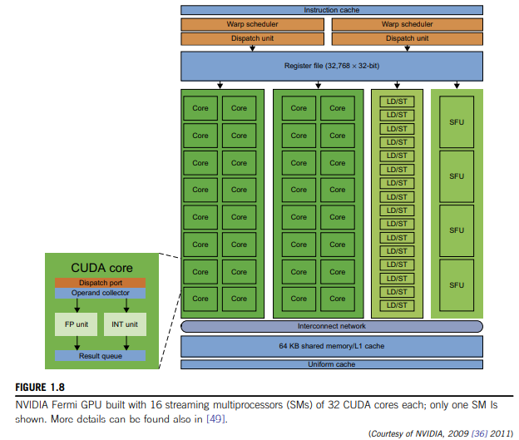

Slide 14
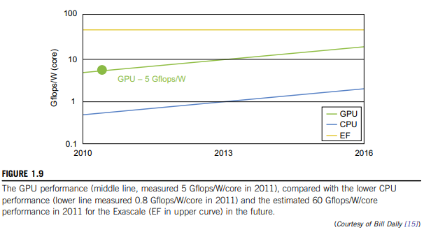
Power Efficiency of the GPU
Below figure compares CPU & GPU performance/power ratio measured in Gflops/watt per core:
2010 - GPU had a value of 5 Gflops/watt at core level, compared with less than 1 Gflop/watt per CPU core.
This implies that both power and software are the real challenges in future parallel and distributed computing systems.

Slide 15
Memory, Storage, and Wide-Area Networking
Memory Technology
Memory access time did not improve much in the past.
Memory wall problem is getting worse as the processor gets faster.
For hard drives, capacity increased from 260 MB in 1981 to 250 GB in 2004.
The Seagate Barracuda XT hard drive reached 3 TB in 2011.
This represents an approximately 10x increase in capacity every eight years.
Disks and Storage Technology
Rapid growth of flash memory & solid-state drives (SSDs) – impacts future of HPC and HTC systems.
Eventually, power consumption, cooling, and packaging will limit large system development.

Slide 16
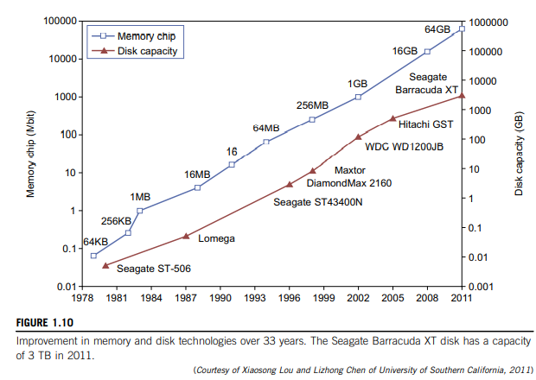

Slide 17
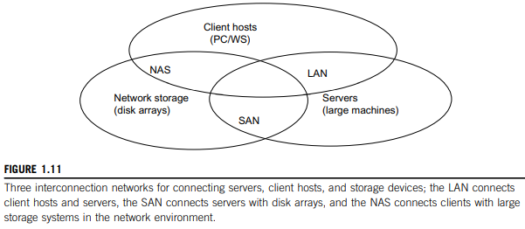
System-Area Interconnects
LAN - used to connect client hosts to big servers.
SAN (Storage area network) - connects servers to network storage such as disk arrays.
NAS (Network attached storage) - connects client hosts directly to the disk arrays.
All three types of networks often appear in a large cluster built with commercial network components.

Slide 18
Wide-Area Networking
Rapid growth of Ethernet bandwidth - 10 Mbps in 1979 to 1 Gbps in 1999) & 40 ~ 100 GE (Gigabit Ethernet) in 2011.
Speculated that 1 Tbps network links will become available by 2013
An increase factor of two per year on network performance was reported,
(faster than Moore’s law on CPU speed doubling every 18 months).
The implication is that more computers will be used concurrently in the future.
High-bandwidth networking - increases the capability - of building massively distributed systems.

Slide 19
Virtual Machines and Virtualization Middleware
A conventional computer has a single OS image.
  - offers a rigid architecture (tightly couples application software to a specific hardware platform).
Some software running well on one machine may not be executable on another platform (different instruction set under a fixed OS).
Virtual machines (VMs) offer novel solutions to underutilized resources, application inflexibility, software manageability, security concerns in existing physical machines.
Today, to build large clusters, grids, and clouds, we need to access large amounts of computing, storage, and networking resources in a virtualized manner (aggregate those resources - offer a single system image).

Slide 20
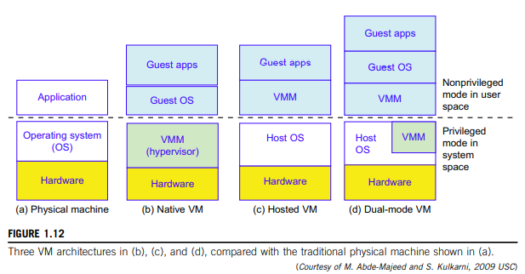

Slide 21
Virtual Machines
In the figure 1.12, host machine is equipped with physical hardware, as shown as the bottom.
The VM is built with virtual resources managed by a guest OS to run a specific application.
Between the VMs and the host platform, one needs to deploy a middleware layer called a virtual machine monitor (VMM).
1.12(b) shows a native VM installed with the use of a VMM called a hypervisor in privileged mode.
This hypervisor approach is also called bare-metal VM, because the hypervisor handles the bare hardware (CPU, memory, and I/O) directly.

Slide 22
Observe the host VM shown in Figure 1.12(c). Here the VMM runs in non privileged mode. The host OS need not be modified.
The VM can also be implemented with a dual mode, as shown in Figure 1.12(d). Part of the VMM runs at the user level and another part runs at the supervisor level.
In this case, the host OS may have to be modified to some extent.
Multiple VMs can be ported to a given hardware system to support the virtualization process.
The VM approach offers hardware independence of the OS and applications.

Slide 23
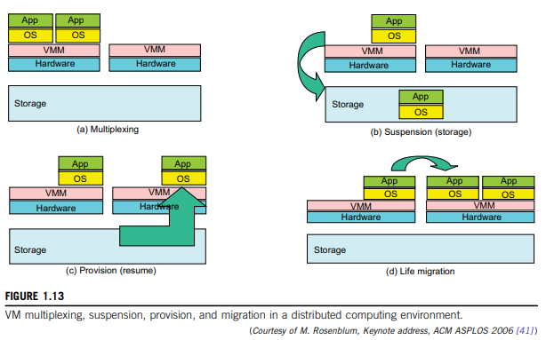
VM Primitive Operations
VMM provides the VM abstraction to the guest OS.
With full virtualization, the VMM exports a VM abstraction identical to the physical machine so that a standard OS such as Windows 2000 or Linux can run just as it would on the physical hardware.
Low-level VMM operations illustrated in Figure 1.13.

Slide 24
VMs can be multiplexed between hardware machines (Figure 1.13(a)).
A VM can be suspended and stored in stable storage (Figure 1.13(b)).
A suspended VM can be resumed or provisioned to a new hardware platform (Figure 1.13(c)).
A VM can be migrated from one hardware platform to another (Figure 1.13(d)).
These VM operations enable a VM to be provisioned to any available hardware platform.
Also enable flexibility in porting distributed application executions.
Further enhances the utilization of server resources.
Note: **Multiple server functions can be consolidated on the same hardware platform to achieve higher system efficiency

Slide 25
Virtual Infrastructures
Virtual infrastructure is what connects resources to distributed applications.
It is a dynamic mapping of system resources to specific applications.
Result - decreased costs, increased efficiency & responsiveness.
Ex: Virtualization for server consolidation and containment.

Slide 26
Data Center Virtualization for Cloud Computing
Here we discuss basic architecture & design considerations of data centers.
Cloud architecture - built with commodity hardware & network devices.
Almost all cloud platforms choose the popular x86 processors.
Low-cost terabyte disks and Gigabit Ethernet - used to build data centers.
Data center design emphasizes the performance/price ratio over speed performance alone.
In other words, storage and energy efficiency are more important than shear speed performance.
Figure 1.14 shows the server growth and cost breakdown of data centers over the past 15 years.
Worldwide, about 43 million servers are in use as of 2010.
The cost of utilities exceeds the cost of hardware after three years.

Slide 27
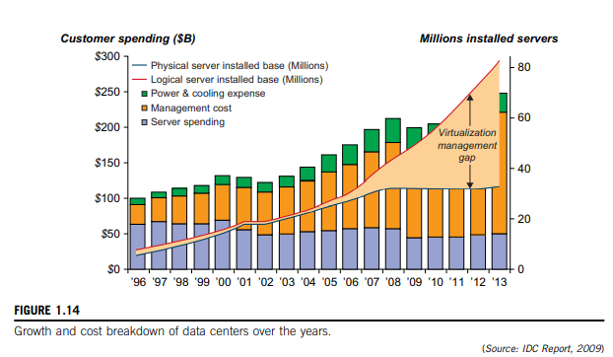

Slide 28
Data Center Growth and Cost Breakdown
A large data center may be built with thousands of servers.
Smaller data centers are typically built with hundreds of servers.
The cost to build and maintain data center servers has increased over the years.
Low-Cost Design Philosophy
High-end switches or routers may be too costly for building data centers.
Thus, using high-bandwidth networks may not fit the economics of cloud computing.
x86 servers are more desirable than expensive mainframes.
Currently, nearly all cloud computing data centers use Ethernet as their fundamental network technology.

Slide 29
Convergence of Technologies
Cloud computing is enabled by convergence of technologies in four areas:
(1) hardware virtualization and multi-core chips,
(2) utility and grid computing,
(3) SOA, Web 2.0, and WS mashups, and
(4) atonomic computing and data center automation.
Hardware virtualization and multicore chips - enable the existence of dynamic configurations in the cloud.
Utility and grid computing technologies - lay the necessary foundation for computing clouds.
Recent advances in SOA, Web 2.0, and mashups of platforms - pushing the cloud another step forward.
Finally, achievements in autonomic computing and automated data center operations - contribute to the rise of cloud computing.

